Slide 1
Xamarin App Development with Visual Studio
Mobile Development - Lab 3

Slide 2

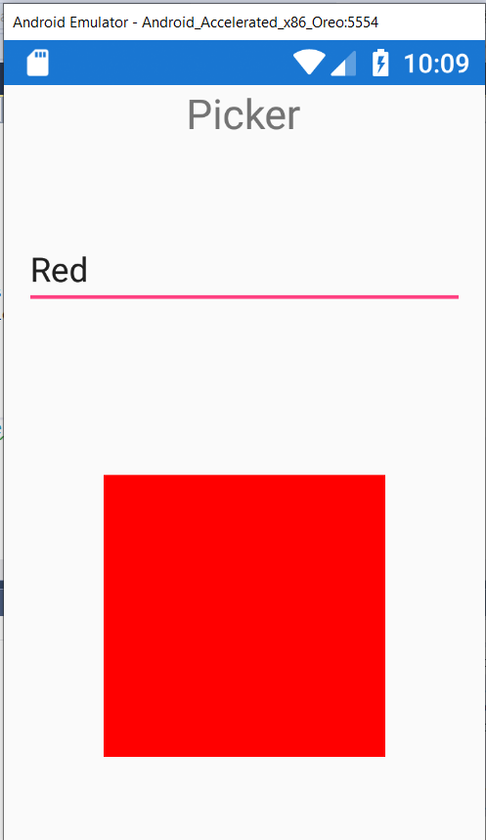
Picker in Forms (without implicit code)

Slide 3
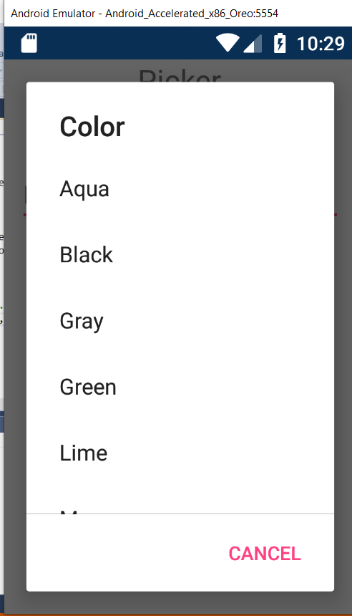

Slide 4


Slide 5


Slide 6


Slide 7


Slide 8


Slide 9


Slide 10


